Slide 1
Introduction
Notes:
Schedule: Timing Topic
60 minutes Lecture
60 minutes Total

Slide 2
Objectives
After completing this lesson, you should be able
to do the following:
List the features of Oracle9i
Discuss the theoretical and physical aspects of a relational database
Describe the Oracle implementation of the RDBMS and ORDBMS
Notes:
Lesson Aim
In this lesson, you gain an understanding of the relational database management system (RDBMS) and the object relational database management system (ORDBMS). You are also introduced to the following:
SQL statements that are specific to Oracle
iSQL*Plus, which is used for executing SQL and for formatting and reporting purposes

Slide 3

Oracle9i
Scalability
One
vendor
One management
interface
Reliability
Single development
model
Common
skill sets
Notes:
Oracle9i Features
Oracle offers a comprehensive high-performance infrastructure for e-business. It is called Oracle9i. Oracle9i includes everything needed to develop, deploy, and manage Internet applications.
Benefits include:
Scalability from departments to enterprise e-business sites
Robust, reliable, available, secure architecture
One development model, easy deployment options
Leverage an organization’s current skillset throughout the Oracle platform (including SQL, PL/SQL, Java, and XML)
One management interface for all applications
Industry standard technologies, no proprietary lock-in

Slide 4


Oracle9i
Notes:
Oracle9i
There are two products, Oracle9i Application Server and Oracle9i Database, that provide a complete and simple infrastructure for Internet applications.

Slide 5

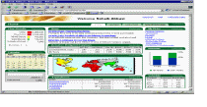
Oracle9i Application Server
Portals
Portals
A
Transactional Apps
Transactional Apps
P
A
C
Business Intelligence
Business intelligence
H
E
Integration
Integration
Notes:
Oracle9i Application Server
The Oracle9i Application Server (Oracle9iAS) runs all your applications. The Oracle9i Database stores all your data.
Oracle9i Application Server is the only application server to include services for all the different server applications you will want to run. Oracle9iAS can run your:
Portals or Web sites
Java transactional applications
Business intelligence applications
It also provides integration between users, applications, and data throughout your organization.
Instructor Note
Apache is used to maintain an open-source HTTP server software product for various modern desktop and server operating systems. It provides a secure, efficient and extensible server with HTTP services in synchronization with the current HTTP standards.
Oracle9iAS is powered by Apache, which is the de facto industry standard.

Slide 6


Oracle9i Database
Object Relational Data
Object Relational Data
Multimedia
Multimedia
Messages
Messages
Notes:
Oracle9i Database
The roles of the two products are very straightforward. Oracle9i Database manages all your data. This is not just the object relational data that you expect an enterprise database to manage. It can also be unstructured data like:
Spreadsheets
Word documents
PowerPoint presentations
XML
Multimedia data types like MP3, graphics, video, and more
The data does not even have to be in the database. Oracle9i Database has services through which you can store metadata about information stored in file systems. You can use the database server to manage and serve information wherever it is located.
Instructor Note
XML (the Extensible Markup Language) was first ratified by the W3C (World Wide Web Consortium) as the standard for information exchange on the Internet in February 1998. Since then it has been rapidly gaining momentum as the development community has begun to appreciate its potential and as vendors have started to deliver tools to support it. XML specifies a rigorous, text-based way to represent the structure inherent in data so that it can be authored and interpreted unambiguously.

Slide 7
Relational and Object Relational Database Management System
Relational model and object relational model
User-defined data types and objects
Fully compatible with relational database
Support of multimedia and large objects
High-quality database server features
Notes:
About the Oracle Server
The Oracle9i server supports both the relational and object relation models.
The Oracle server extends the data modeling capabilities to support an object relational database model that brings object-oriented programming, complex data types, complex business objects, and full compatibility with the relational world.
It includes several features for improved performance and functionality of online transaction processing (OLTP) applications, such as better sharing of run-time data structures, larger buffer caches, and deferrable constraints. Data warehouse applications will benefit from enhancements such as parallel execution of insert, update, and delete operations; partitioning; and parallel-aware query optimization. Operating within the Network Computing Architecture (NCA) framework, Oracle9i supports client-server and Web-based applications that are distributed and multitiered.
Oracle9i can scale tens of thousands of concurrent users, support up to 512 petabytes of data (a petabyte is 1,000 terabytes), and can handle any type of data, including text, spatial, image, sound, video, and time series as well as traditional structured data.
For more information, see Oracle9i Concepts.
Instructor Note
The Object Relation Database Management System features are available with release 8 and higher.
Oracle7 is a relational database management system and Oracle8, 8i, and 9i are object relational database management systems.

Slide 8



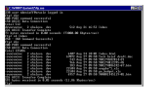
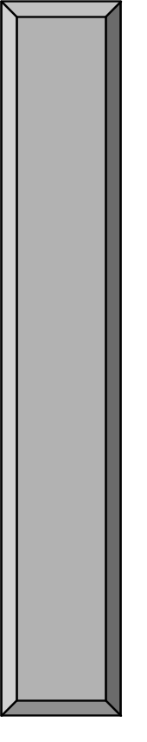



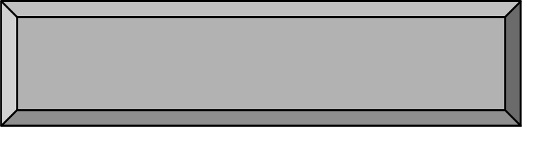

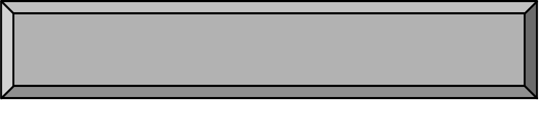

Oracle Internet Platform
Clients
Any mail
client
Any browser
Any FTP client
Internet applications
SQL
Business logic
and data
Presentation and
business logic
System management
Development tools
PL/SQL
Application
servers
Databases
Java
Network services
Notes:
Oracle Internet Platform
Oracle offers a comprehensive high-performance Internet platform for e-commerce and data warehousing. This integrated platform includes everything needed to develop, deploy, and manage Internet applications. The Oracle Internet Platform is built on three core pieces:
Browser-based clients to process presentation
Application servers to execute business logic and serve presentation logic to browser-based clients
Databases to execute database-intensive business logic and serve data
Oracle offers a wide variety of the most advanced graphical user interface (GUI) driven development tools to build business applications, as well as a large suite of software applications for many areas of business and industry. Stored procedures, functions, and packages can be written by using SQL, PL/SQL, or Java.

Slide 9
System Development Life Cycle
Strategy
and
analysis
Design
Build
and
document
Transition
Production
Notes:
System Development Life Cycle
From concept to production, you can develop a database by using the system development life cycle, which contains multiple stages of development. This top-down, systematic approach to database development transforms business information requirements into an operational database.
Strategy and Analysis
Study and analyze the business requirements. Interview users and managers to identify the information requirements. Incorporate the enterprise and application mission statements as well as any future system specifications.
Build models of the system. Transfer the business narrative into a graphical representation of business information needs and rules. Confirm and refine the model with the analysts and experts.
Design
Design the database based on the model developed in the strategy and analysis phase.
Build and Document
Build the prototype system. Write and execute the commands to create the tables and supporting objects for the database.
Develop user documentation, Help text, and operations manuals to support the use and operation of the system.

Slide 10
System Development Life Cycle
Strategy
and
analysis
Design
Build
and
document
Transition
Production
Notes:
System Development Life Cycle (continued)
Transition
Refine the prototype. Move an application into production with user acceptance testing, conversion of existing data, and parallel operations. Make any modifications required.
Production
Roll out the system to the users. Operate the production system. Monitor its performance, and enhance and refine the system.
Note: The various phases of the system development life cycle can be carried out iteratively. This course focuses on the build phase of the system development life cycle.

Slide 11
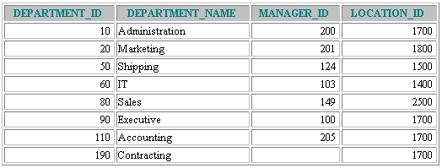
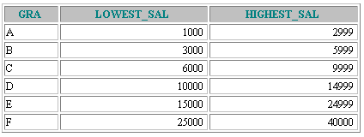
Data Storage on Different Media
Database
Electronic spreadsheet
Filing cabinet
Notes:
Storing Information
Every organization has some information needs. A library keeps a list of members, books, due dates, and fines. A company needs to save information about employees, departments, and salaries. These pieces of information are called data.
Organizations can store data on various media and in different formats, such as a hard-copy document in a filing cabinet or data stored in electronic spreadsheets or in databases.
A database is an organized collection of information.
To manage databases, you need database management systems (DBMS). A DBMS is a program that stores, retrieves, and modifies data in the database on request. There are four main types of databases: hierarchical, network, relational, and more recently object relational.

Slide 12
Relational Database Concept
Dr. E.F. Codd proposed the relational model for database systems in 1970.
It is the basis for the relational database management system (RDBMS).
The relational model consists of the following:
  Collection of objects or relations
  Set of operators to act on the relations
  Data integrity for accuracy and consistency
Notes:
Relational Model
The principles of the relational model were first outlined by Dr. E. F. Codd in a June 1970 paper called “A Relational Model of Data for Large Shared Data Banks.” In this paper, Dr. Codd proposed the relational model for database systems.
The more popular models used at that time were hierarchical and network, or even simple flat file data structures. Relational database management systems (RDBMS) soon became very popular, especially for their ease of use and flexibility in structure. In addition, a number of innovative vendors, such as Oracle, supplemented the RDBMS with a suite of powerful application development and user products, providing a total solution.
Components of the Relational Model
Collections of objects or relations that store the data
A set of operators that can act on the relations to produce other relations
Data integrity for accuracy and consistency
For more information, see E. F. Codd, The Relational Model for Database Management Version 2 (Reading, Mass.: Addison-Wesley, 1990).

Slide 13


Definition of a Relational Database
A relational database is a collection of relations or
two-dimensional tables.
Oracle
server
Table Name: EMPLOYEES
Table Name: DEPARTMENTS
…
…
Notes:
Definition of a Relational Database
A relational database uses relations or two-dimensional tables to store information.
For example, you might want to store information about all the employees in your company. In a relational database, you create several tables to store different pieces of information about your employees, such as an employee table, a department table, and a salary table.

Slide 14
Data Models
Model of
system
in client’s
mind
Entity model of
client’s model
Table model
of entity model
Oracle
server
Tables on disk
Notes:
Data Models
Models are a cornerstone of design. Engineers build a model of a car to work out any details before putting it into production. In the same manner, system designers develop models to explore ideas and improve the understanding of the database design.
Purpose of Models
Models help communicate the concepts in people’s minds. They can be used to do the following:
Communicate
Categorize
Describe
Specify
Investigate
Evolve
Analyze
Imitate
The objective is to produce a model that fits a multitude of these uses, can be understood by an end user, and contains sufficient detail for a developer to build a database system.

Slide 15
Entity Relationship Model
  Create an entity relationship diagram from business specifications or narratives
  Scenario
    “. . . Assign one or more employees to a department . . .”
    “. . . Some departments do not yet have assigned employees . . .”
EMPLOYEE
#* number
* name
o job title
DEPARTMENT
#* number
* name
o location
assigned to
composed of
Notes:
ER Modeling
In an effective system, data is divided into discrete categories or entities. An entity relationship (ER) model is an illustration of various entities in a business and the relationships between them. An ER model is derived from business specifications or narratives and built during the analysis phase of the system development life cycle. ER models separate the information required by a business from the activities performed within a business. Although businesses can change their activities, the type of information tends to remain constant. Therefore, the data structures also tend to be constant.
Benefits of ER Modeling
Documents information for the organization in a clear, precise format
Provides a clear picture of the scope of the information requirement
Provides an easily understood pictorial map for the database design
Offers an effective framework for integrating multiple applications
Key Components
Entity: A thing of significance about which information needs to be known. Examples are departments, employees, and orders.
Attribute: Something that describes or qualifies an entity. For example, for the employee entity, the attributes would be the employee number, name, job title, hire date, department number, and so on. Each of the attributes is either required or optional. This state is called optionality.
Relationship: A named association between entities showing optionality and degree. Examples are employees and departments, and orders and items.

Slide 16
Entity Relationship
Modeling Conventions
Entity
Soft box
Singular, unique name
Uppercase
Synonym in parentheses
Attribute
Singular name
Lowercase
Mandatory marked with “*”
Optional marked with “o”
EMPLOYEE
#* number
* name
o job title
DEPARTMENT
#* number
* name
o location
assigned to
composed of
Unique Identifier (UID)
Primary marked with “#”
Secondary marked with “(#)”
Notes:
ER Modeling (continued)
Entities
To represent an entity in a model, use the following conventions:
Soft box with any dimensions
Singular, unique entity name
Entity name in uppercase
Optional synonym names in uppercase within parentheses: ( )
Attributes
To represent an attribute in a model, use the following conventions:
Use singular names in lowercase.
Tag mandatory attributes, or values that must be known, with an asterisk: *.
Tag optional attributes, or values that may be known, with the letter o.
Relationships

Slide 17
Entity Relationship
Modeling Conventions
Entity
Soft box
Singular, unique name
Uppercase
Synonym in parentheses
Attribute
Singular name
Lowercase
Mandatory marked with “*”
Optional marked with “o”
EMPLOYEE
#* number
* name
o job title
DEPARTMENT
#* number
* name
o location
assigned to
composed of
Unique Identifier (UID)
Primary marked with “#”
Secondary marked with “(#)”
Notes:
ER Modeling (continued)
Relationships
Each direction of the relationship contains:
A label, for example, taught by or assigned to
An optionality, either must be or may be
A degree, either one and only one or one or more
Note: The term cardinality is a synonym for the term degree.
Each source entity {may be | must be} relationship name {one and only one | one or more} destination entity.
Note: The convention is to read clockwise.
Unique Identifiers
A unique identifier (UID) is any combination of attributes or relationships, or both, that serves to distinguish occurrences of an entity. Each entity occurrence must be uniquely identifiable.
Tag each attribute that is part of the UID with a number symbol: #
Tag secondary UIDs with a number sign in parentheses: (#)

Slide 18
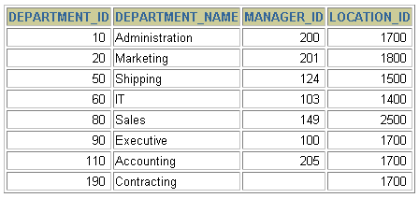
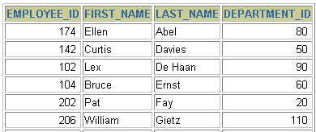
Relating Multiple Tables
Each row of data in a table is uniquely identified by a primary key (PK).
You can logically relate data from multiple tables using foreign keys (FK).
Table Name: DEPARTMENTS
Table Name: EMPLOYEES
…
Primary key
Foreign key
Primary key
Notes:
Relating Multiple Tables
Each table contains data that describes exactly one entity. For example, the EMPLOYEES table contains information about employees. Categories of data are listed across the top of each table, and individual cases are listed below. Using a table format, you can readily visualize, understand, and use information.
Because data about different entities is stored in different tables, you may need to combine two or more tables to answer a particular question. For example, you may want to know the location of the department where an employee works. In this scenario, you need information from the EMPLOYEES table (which contains data about employees) and the DEPARTMENTS table (which contains information about departments). With an RDBMS you can relate the data in one table to the data in another by using the foreign keys. A foreign key is a column or a set of columns that refer to a primary key in the same table or another table.
You can use the ability to relate data in one table to data in another to organize information in separate, manageable units. Employee data can be kept logically distinct from department data by storing it in a separate table.
Guidelines for Primary Keys and Foreign Keys
You cannot use duplicate values in a primary key.
Primary keys generally cannot be changed.
Foreign keys are based on data values and are purely logical, not physical, pointers.
A foreign key value must match an existing primary key value or unique key value, or else be null.
A foreign key must reference either a primary key or unique key column.

Slide 19
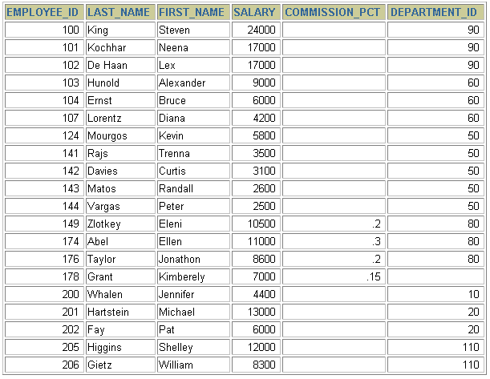
Relational Database Terminology
3
4
2
6
5
1
Notes:
Terminology Used in a Relational Database
A relational database can contain one or many tables. A table is the basic storage structure of an RDBMS. A table holds all the data necessary about something in the real world, such as employees, invoices, or customers.
The slide shows the contents of the EMPLOYEES table or relation. The numbers indicate the following:
1. A single row or table representing all data required for a particular employee. Each row in a table should be identified by a primary key, which allows no duplicate rows. The order of rows is insignificant; specify the row order when the data is retrieved.
2. A column or attribute containing the employee number. The employee number identifies a unique employee in the EMPLOYEES table. In this example, the employee number column is designated as the primary key. A primary key must contain a value, and the value must be unique.
3. A column that is not a key value. A column represents one kind of data in a table; in the example, the salary of all the employees. Column order is insignificant when storing data; specify the column order when the data is retrieved.
4. A column containing the department number, which is also a foreign key. A foreign key is a column that defines how tables relate to each other. A foreign key refers to a primary key or a unique key in the same table or in another table. In the example, DEPARTMENT_ID uniquely identifies a department in the DEPARTMENTS table.
5. A field may have no value in it. This is called a null value. In the EMPLOYEES table, only employees who have a role of sales representative have a value in the COMMISSION_PCT (commission) field.
6. A field can be found at the intersection of a row and a column. There can be only one value in it.

Slide 20
Relational Database Properties
A relational database:
Can be accessed and modified by executing structured query language (SQL) statements
Contains a collection of tables with no physical pointers
Uses a set of operators
Notes:
Properties of a Relational Database
In a relational database, you do not specify the access route to the tables, and you do not need to know how the data is arranged physically.
To access the database, you execute a structured query language (SQL) statement, which is the American National Standards Institute (ANSI) standard language for operating relational databases. The language contains a large set of operators for partitioning and combining relations. The database can be modified by using the SQL statements.

Slide 21
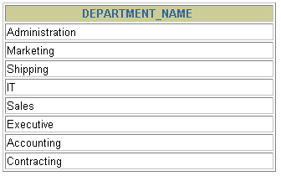
Communicating with a RDBMS
Using SQL
SQL statement
is entered.
Statement is sent to Oracle Server.
SELECT department_name
FROM departments;
Oracle
server
Notes:
Structured Query Language
Using SQL, you can communicate with the Oracle server. SQL has the following advantages:
Efficient
Easy to learn and use
Functionally complete (With SQL, you can define, retrieve, and manipulate data in the tables.)

Slide 22
Relational Database Management System
Oracle
server
User tables
Data
dictionary
Notes:
Relational Database Management System
Oracle provides a flexible RDBMS called Oracle9i. Using its features, you can store and manage data with all the advantages of a relational structure plus PL/SQL, an engine that provides you with the ability to store and execute program units. Oracle9i also supports Java and XML. The Oracle server offers the options of retrieving data based on optimization techniques. It includes security features that control how a database is accessed and used. Other features include consistency and protection of data through locking mechanisms.
The Oracle9i server provides an open, comprehensive, and integrated approach to information management. An Oracle server consists of an Oracle database and an Oracle server instance. Every time a database is started, a system global area (SGA) is allocated, and Oracle background processes are started. The system global area is an area of memory used for database information shared by the database users. The combination of the background processes and memory buffers is called an Oracle instance.

Slide 23
SQL Statements
SELECT
INSERT
UPDATE
DELETE
MERGE
CREATE
ALTER
DROP
RENAME
TRUNCATE
COMMIT
ROLLBACK
SAVEPOINT
GRANT
REVOKE
Data retrieval
Data manipulation language (DML)
Data definition language (DDL)
Transaction control
Data control language (DCL)
Notes:
SQL Statements
Oracle SQL complies with industry-accepted standards. Oracle Corporation ensures future compliance with evolving standards by actively involving key personnel in SQL standards committees. Industry-accepted committees are the American National Standards Institute (ANSI) and the International Standards Organization (ISO). Both ANSI and ISO have accepted SQL as the standard language for relational databases.

Slide 24
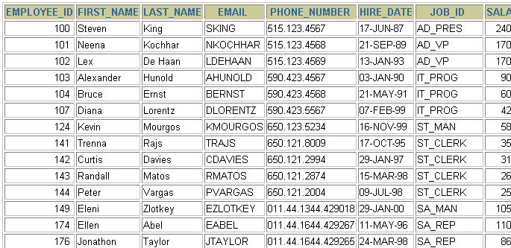
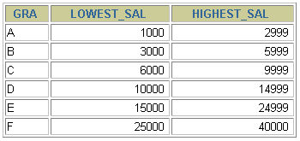
Tables Used in the Course
EMPLOYEES
DEPARTMENTS
JOB_GRADES
Notes:
Tables Used in the Course
The following main tables are used in this course:
EMPLOYEES table, which gives details of all the employees
DEPARTMENTS table, which gives details of all the departments
JOB_GRADES table, which gives details of salaries for various grades
Note: The structure and data for all the tables are provided in Appendix B.
Instructor Note
This course uses the Sample Schema that is shipped with the Oracle9i database. The full Sample Schema consists of several subschemas. One of the subschemas is called HR (Human Resources). This course uses the HR portion of the Sample Schema. Some of the rows from the HR schema are removed to simplify examples in this courseware.
Have the students turn to Appendix B to review the tables used in the course.

Slide 25
Summary
The Oracle9i Server is the database for Internet computing.
Oracle9i is based on the object relational database management system.
Relational databases are composed of relations, managed by relational operations, and governed by data integrity constraints.
With the Oracle Server, you can store and manage information by using the SQL language and PL/SQL engine.
Notes:
Summary
Relational database management systems are composed of objects or relations. They are managed by operations and governed by data integrity constraints.
Oracle Corporation produces products and services to meet your relational database management system needs. The main products are the Oracle9i Database Server, with which you can store and manage information by using SQL, and the Oracle9i Application Server with which you can run all of your applications.
SQL
The Oracle Server supports ANSI standard SQL and contains extensions. SQL is the language used to communicate with the server to access, manipulate, and control data.

